Slide 1

DEPARTMENT OF COMPUTER SCIENCE & ENGINEERING
ACHARYA INSTITUTE OF TECHNOLOGY SOLADEVANAHALLI, BENGALURU-560107
Academic Project Presentation on
“Sequential Sentence Classification in Medical Abstracts”
Presented by: Under the guidance of:
Akshay G S(1AY18CS008) Dr.Ajith Padyana
Dhruv K (1AY18CS038) Associate Professor & Head
Anish K(1AY18CS013) Department of CS&E
D Pruthvi Kumar Reddy(1AY18CS035)

Slide 2

CHAPTER-1: INTRODUCTORY SECTION

Slide 3

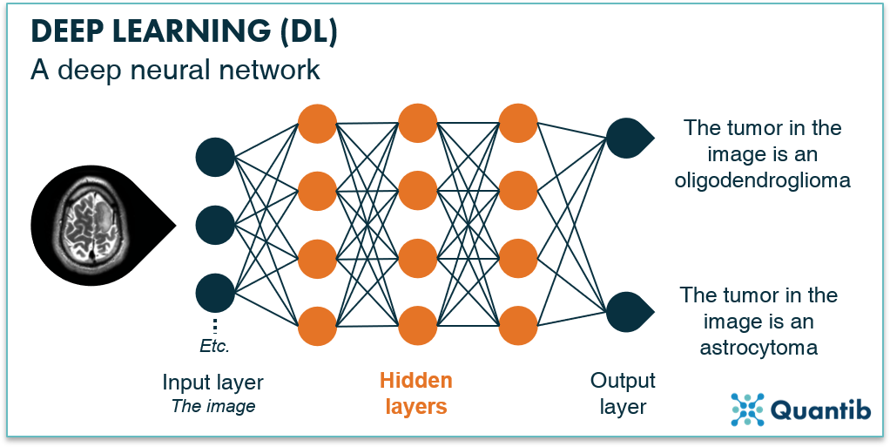

INTRODUCTION
23-July-22

Slide 4

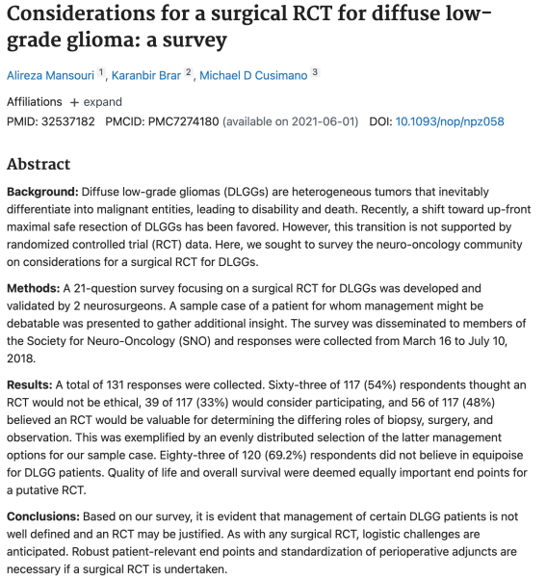

Slide 5
LITERATURE SURVEY

Slide 6
LITERATURE SURVEY
S.N | PAPER TITLE | AUTHORS | TECHNICAL IDEAS/ALGORITHMS | SHORTFALLS/DRAWBACKS
1. | PubMed 200k RCT: a Dataset for Sequential Sentence Classification in Medical Abstracts. | Franck Dernoncour and Ji Young Lee | 200,000 abstracts of a randomized controlled trial | There is no new model architecture that is provided with the dataset for the classification of the dataset.

Slide 7
S.N | PAPER TITLE | AUTHORS | TECHNICAL IDEAS/ALGORITHMS | SHORTFALLS/DRAWBACKS
2. | Sequential Short-Text Classification with Recurrent and Convolutional Neural Networks. | Ji Young Lee, Franck Dernoncourt | Present a model based on RNN and CNN that incorporate the preceding short texts. With this idea, they achieved state-of-art results on three different datasets for dialog act prediction. | They leverage the preceding short text while classifying a subsequent one. But they do not consider finding complex meanings in the text and the the situation of the text or a sentence in the whole paragraph. The proposed system utilizes this method and builds on top of this to make the sentence classification more accurate and precise, having the meaning of the context for every sentence classified.

Slide 8
S.N | PAPER TITLE | AUTHORS | TECHNICAL IDEAS/ALGORITHMS | SHORTFALLS/DRAWBACKS
3. | Universal Sentence Encoder. | Daniel Cera, Yinfei Yanga, Sheng-yi Konga, Nan Huaa, Nicole Limtiacob, Rhomni St. Johna, Noah Constanta, Mario Guajardo-Ce spedes, Steve Yuanc, Chris Tara, Yun-Hsuan Sunga, Brian Stropea, Ray Kurzweila | Presents a model for encoding sentences into embedding vectors that specifically target transfer learning to other NLP tasks. Finds that transfer learning using sentence embeddings tends to outperform word-level transfer. Helps to get better results with a minimum amount of training data. | The transfer learning method that provides the in-depth learning of a model with a large dataset is utilized in the solution presented. But this alone does not help the desired result of classifying the medical abstracts efficiently. The proposed system implements character embedding, word embedding, and also positional embedding, which are not addressed in the paper.

Slide 9
S.N | PAPER TITLE | AUTHORS | TECHNICAL IDEAS/ALGORITHMS | SHORTFALLS/DRAWBACKS
4. | Character-based Neural Embeddings for Tweet Clustering. | Svitlana Vakulenko, Lyndon Nixon, Mihai Lupu. | The proposed approach overcomes the limitations related to the vocabulary explosion in the word-based models and allows for the seamless processing of multilingual content. Utilizing this method, complex words and relations between the words in a sentence can be understood better. | This helps in analyzing non-encountered words but still is not enough for accurate sentence classification. The proposed system utilizes the combination of character embedding with the token(word) embedding for getting better results. Along with these, it also makes use of positional embedding specific to Medical abstracts.

Slide 10
S.N | PAPER TITLE | AUTHORS | TECHNICAL IDEAS/ALGORITHMS | SHORTFALLS/DRAWBACKS
5. | Neural Networks for Joint Sentence Classification in Medical Paper Abstracts. | Franck Dernoncourt, Peter Szolovits | Combines the strength of Structured predictions. This utilizes a popular technique of Glove Embedding. | In addition structure, the proposed solution makes use of all the techniques to get a combined deep learning model architecture that not only learns patterns of characters and words, but also the structure and the context with feature engineered analysis and fine-tuned parameters for the models.

Slide 11
REQUIREMENT ANALYSIS FOR PROJECT IMPLEMENTATION

Slide 12
FUNCTIONAL REQUIREMENTS
Effectively preprocess the data to fit in the model.
To implement the Deep Neural Network Architectures.
Learn the process and factors affecting the learning of the algorithm.
Learn the patterns in the data.
Feature Engineering the model with the knowledge gained from the data.

Slide 13
NON-FUNCTIONAL REQUIREMENTS
Performance
Reliability
Accuracy

Slide 14
SOFTWARE REQUIREMENTS
Browser: Google chrome or any other browser.
Tensorflow,Keras
Google Colab
Tensorflow Hub

Slide 15
HARDWARE REQUIREMENTS
Minimum Requirements
CPU: Intel i3 – 4030U @ 1.9GHz
RAM: 8GB
Google Colab
Recommended Requirements
CPU: Intel i5 processor or above
RAM: 16GB
GPU for training

Slide 16
PROPOSED METHODOLOGY

Slide 17
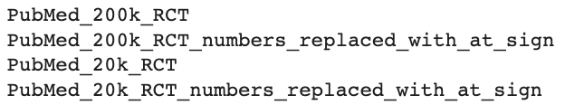
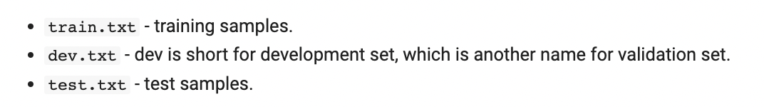
PROPOSED METHODOLOGY
Dataset:

Slide 18
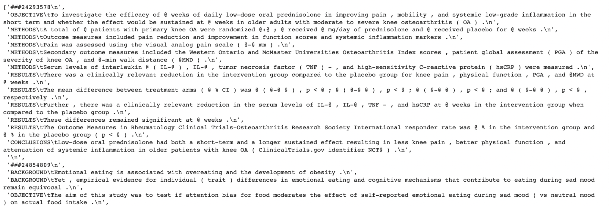
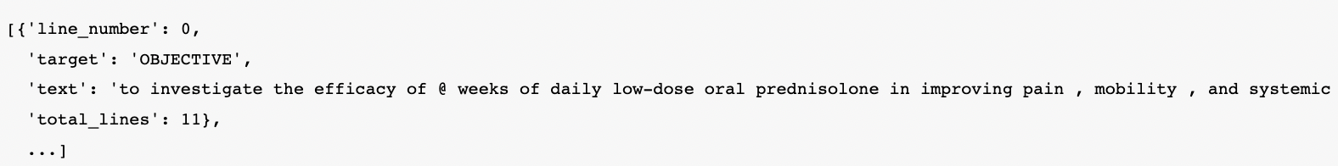
Sample Data:

Slide 19
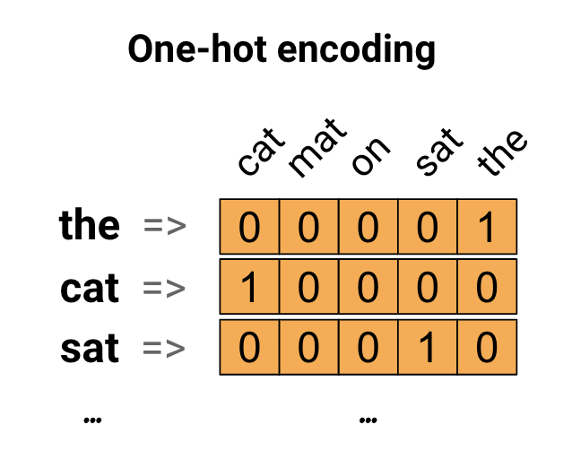
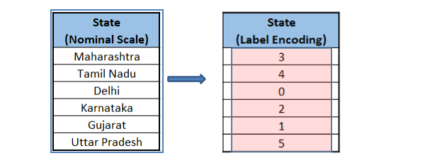

Slide 20
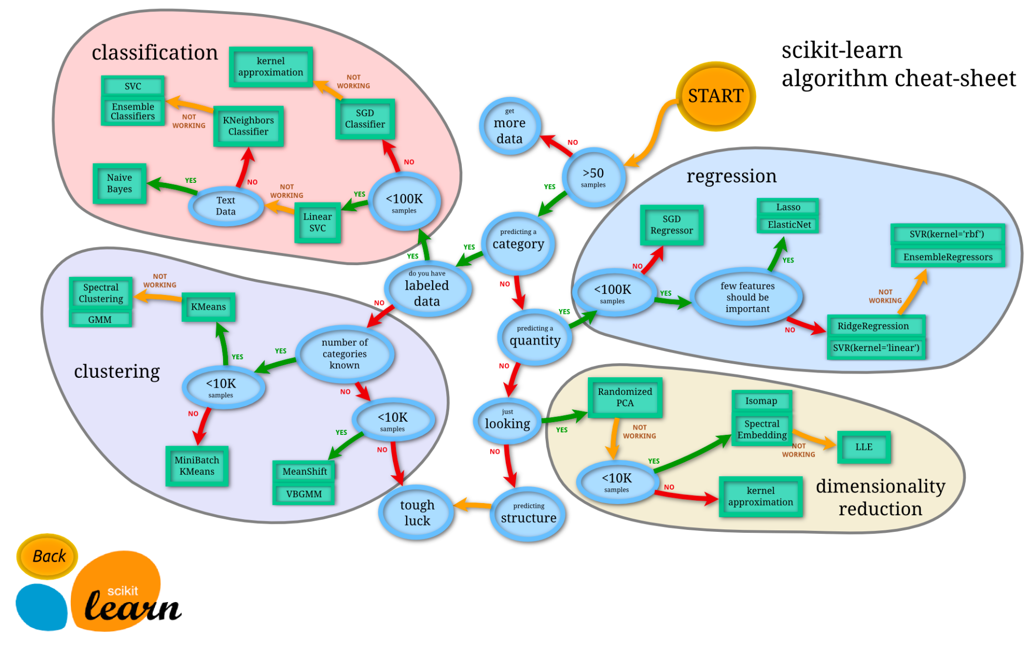

Slide 21
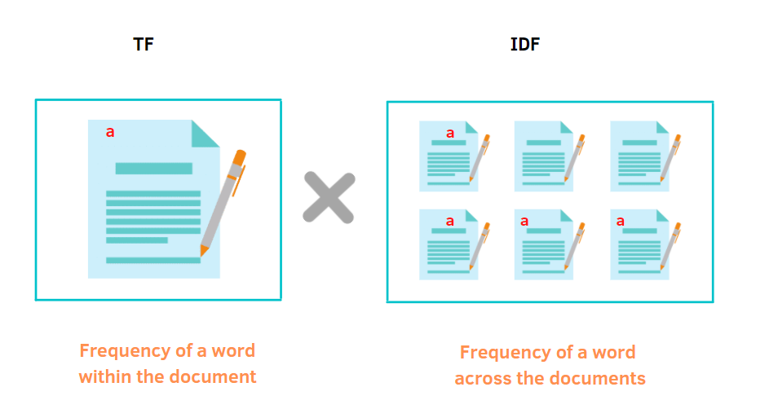

Slide 22
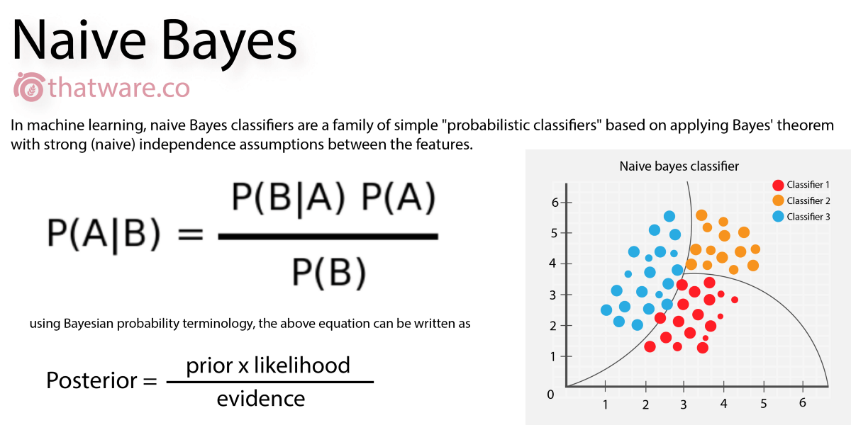

Slide 23
DEEP LEARNING IMPLEMENTATION

Slide 24
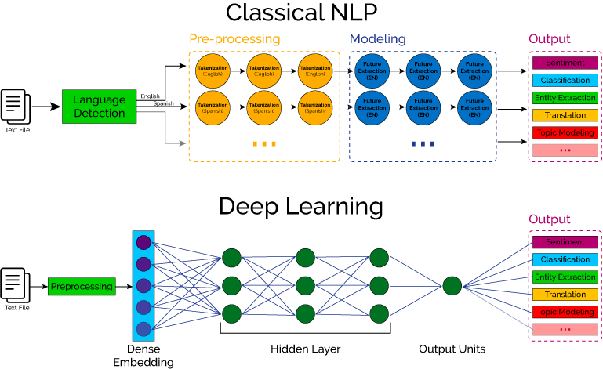

Slide 25
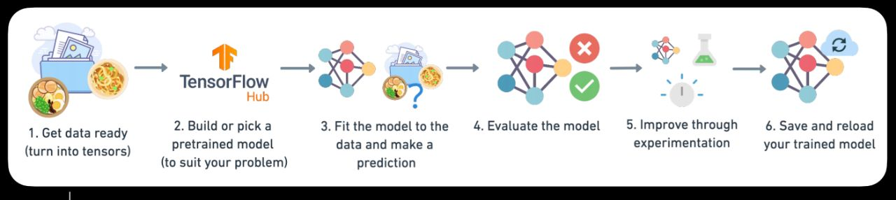
Steps in Modelling with TensorFlow
23-July-22

Slide 26
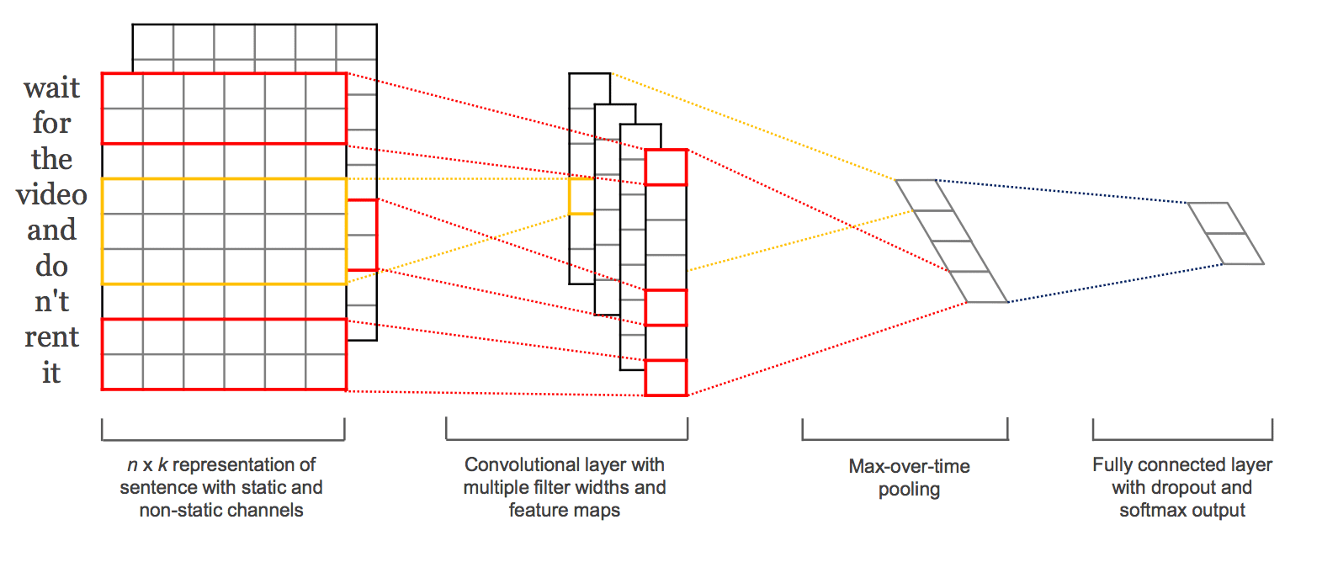
Conv1D with Token Embedding

Slide 27
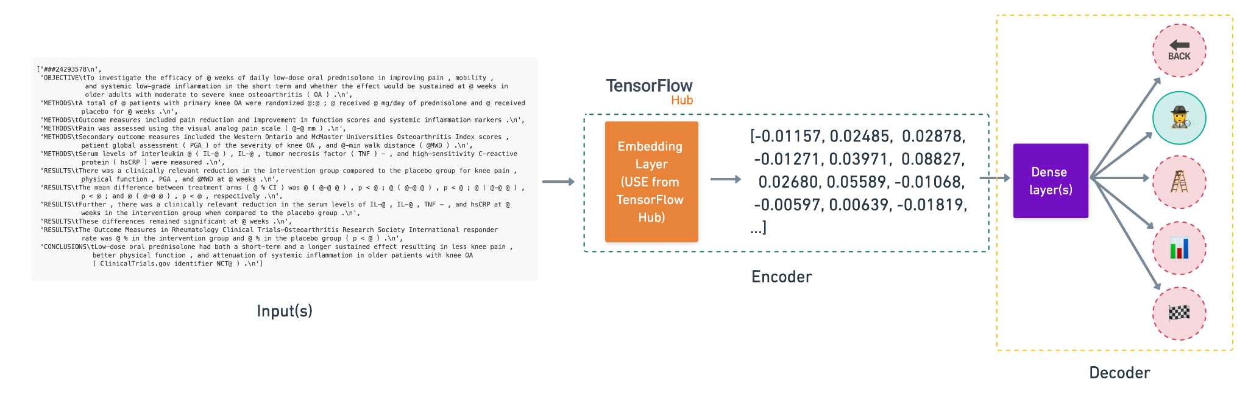
Feature extraction with pre-trained token embeddings

Slide 28
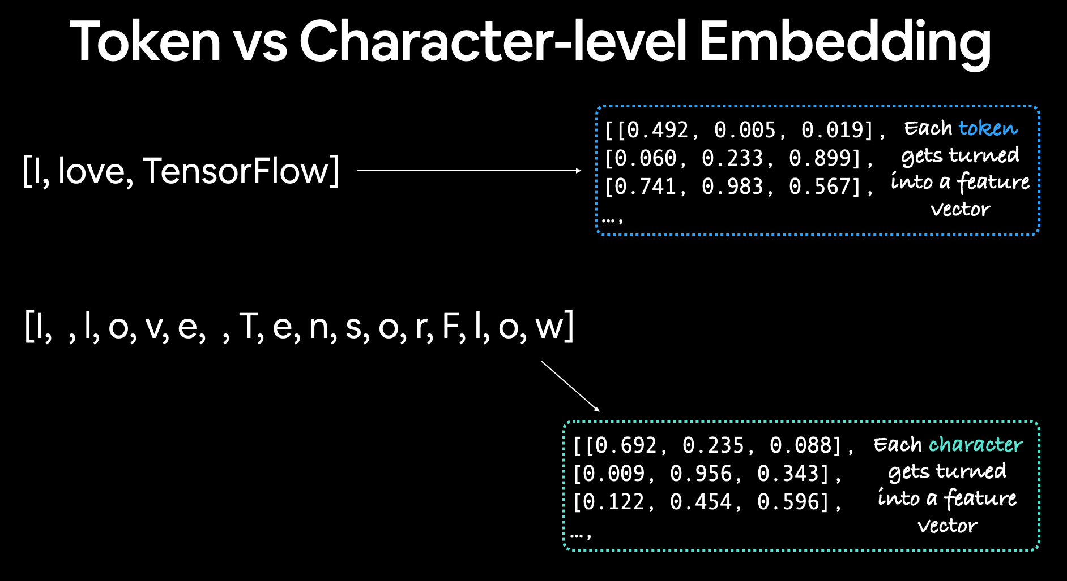

Slide 29
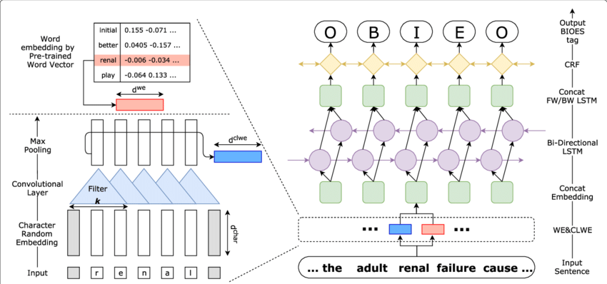
Conv1D with character embeddings

Slide 30
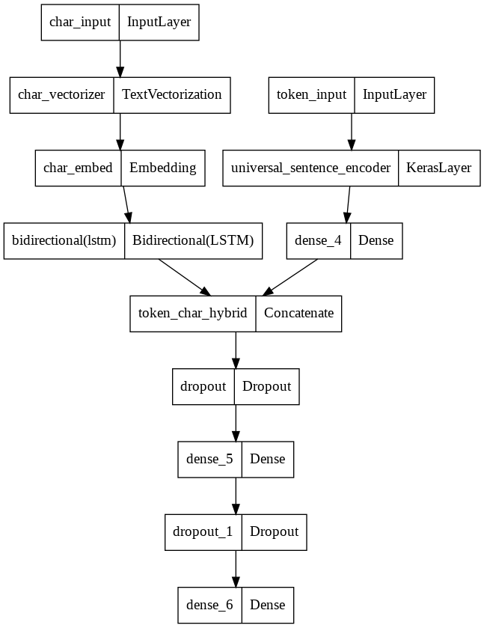
Combining pretrained token embeddings + character embeddings (hybrid embedding layer)

Slide 31
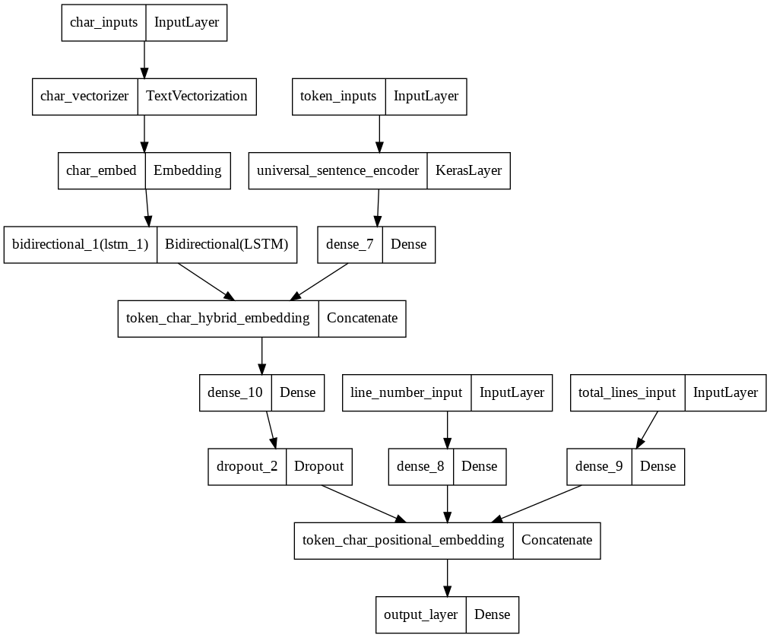
Transfer Learning with pre-trained token embeddings + character embeddings + positional embeddings

Slide 32
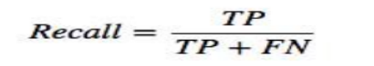

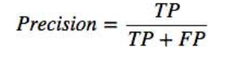
TESTING
1. Recall (true positive rate)
Ratio between the numbers of Positive samples correctly classified to the total number of Positive samples
2. Precision
Calculated by dividing the true positives by anything
that was predicted as a positive.

Slide 33
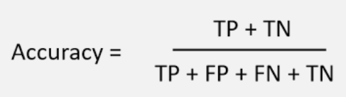
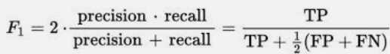
3. Accuracy
It is able to measure the true amount or concentration of a substance in a sample.
4. F1 score
This is used to express the performance of the model high F1-score indicates a high value for both recall and precision. It have combined information about recall & precision

Slide 34
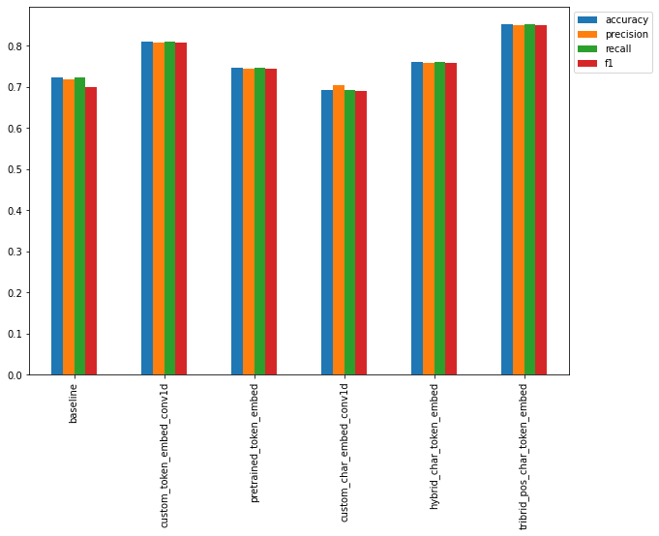
Comparison of the Models
23-July-22

Slide 35
Before and After Results
23-July-22

Slide 36
CONCLUSION & FUTURE SCOPE
6.1. CONCLUSION
To get a quick brief about the Medical research paper.
Save time of the medical professionals.
6.2. FUTURE SCOPE
Find out the reasons for wrong predictions and implement the solution.
Implement this to other kind of research papers.
Deploy the model.

Slide 37
REFERENCES
Source of data for training and validation: PubMed 200k RCT: a Dataset for Sequential Sentence Classification in Medical Abstracts
Model architecture that gave the most accurate results: Neural networks for joint sentence classification in medical paper abstracts

Slide 38
THANK YOU

